Slide 2
Hw for week one
Find, read, summarize 5 papers on
Stress, college students
Add your summaries to your summaries document
Create your paper template, as on github (leave it alone for awhile)
Don’t forget your literature survey, add this (heading)
Add your 5 sources to your bib

Slide 3
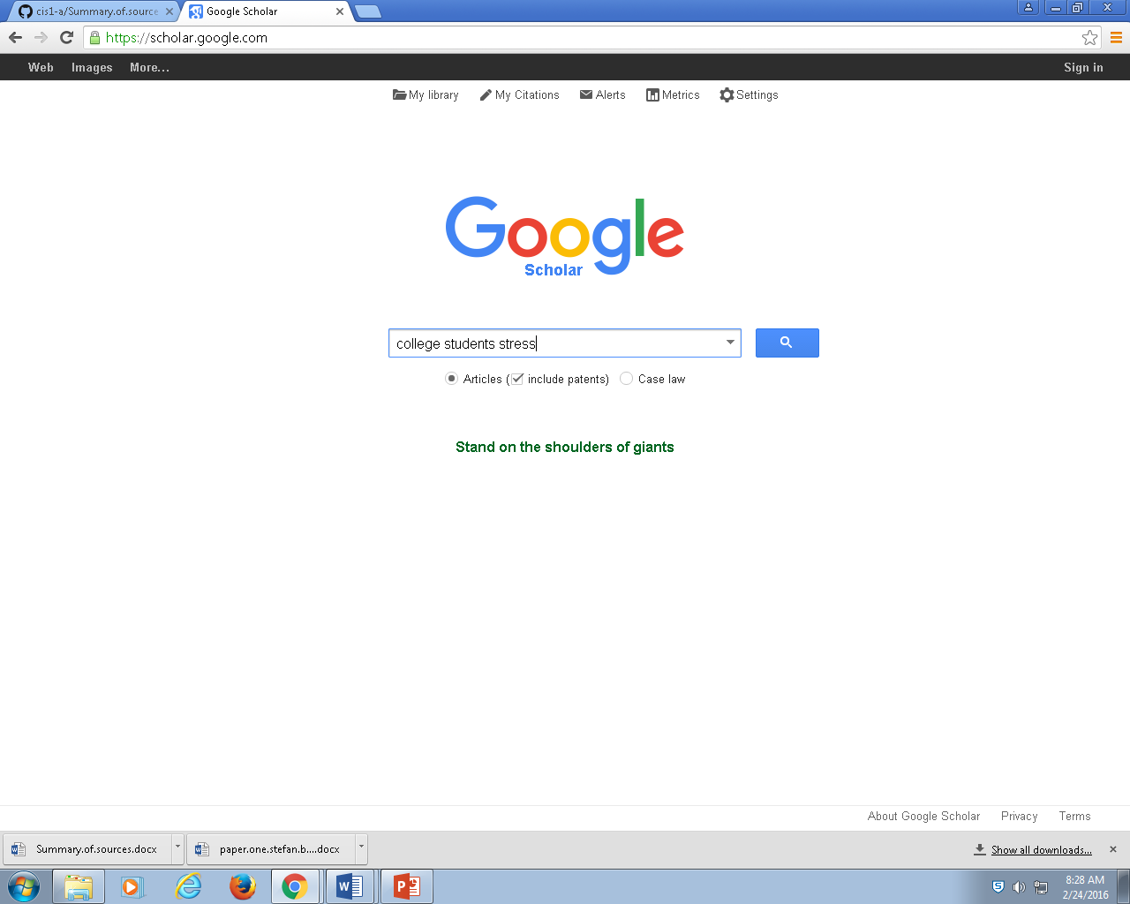

Slide 4
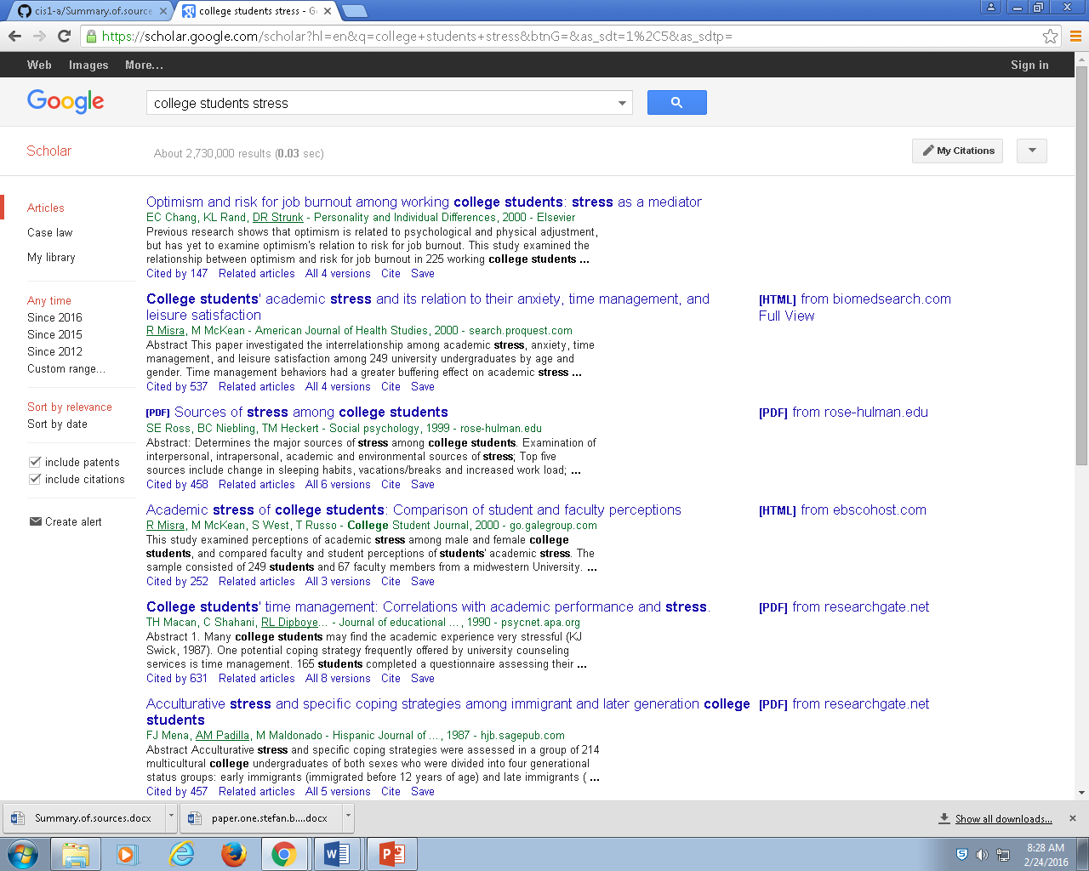
Read the top ones

Slide 5
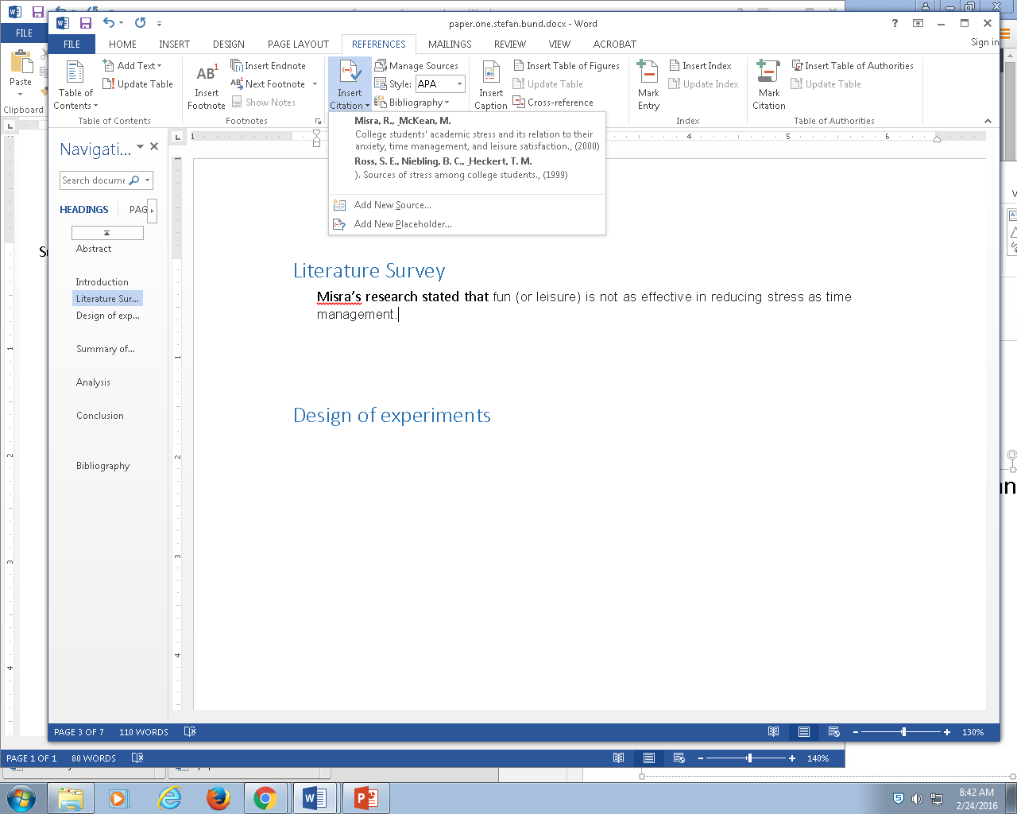
ultimately
The literature survey contains many one-sentence summaries of each article you read

